Slide 1

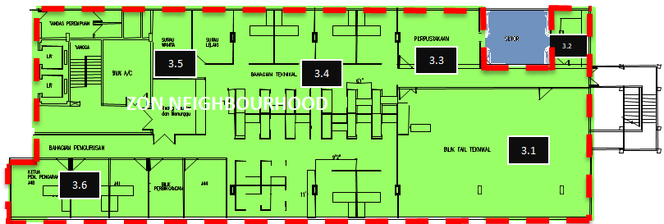
PELAN LANTAI ZON GREEN NEIGHBOURHOOD

